Slide 1




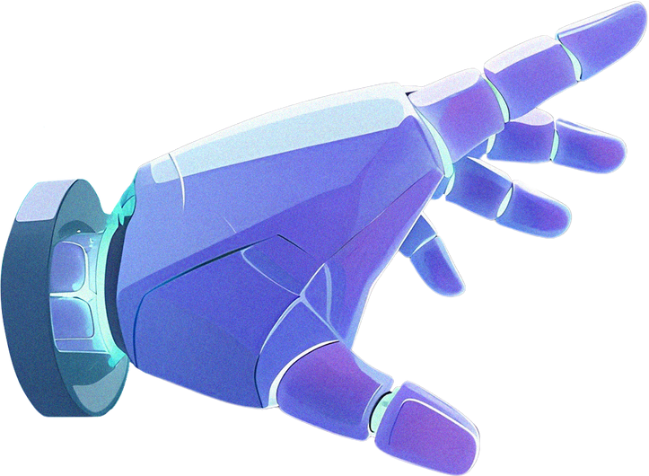
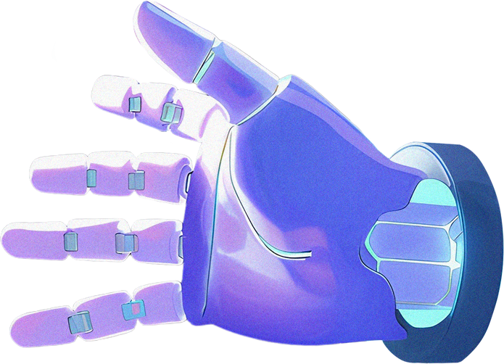


By Chloe Tu
ITAI 2373 Natural Language processing
Modeling a Neural Network
Architecture and Functionality

Slide 2


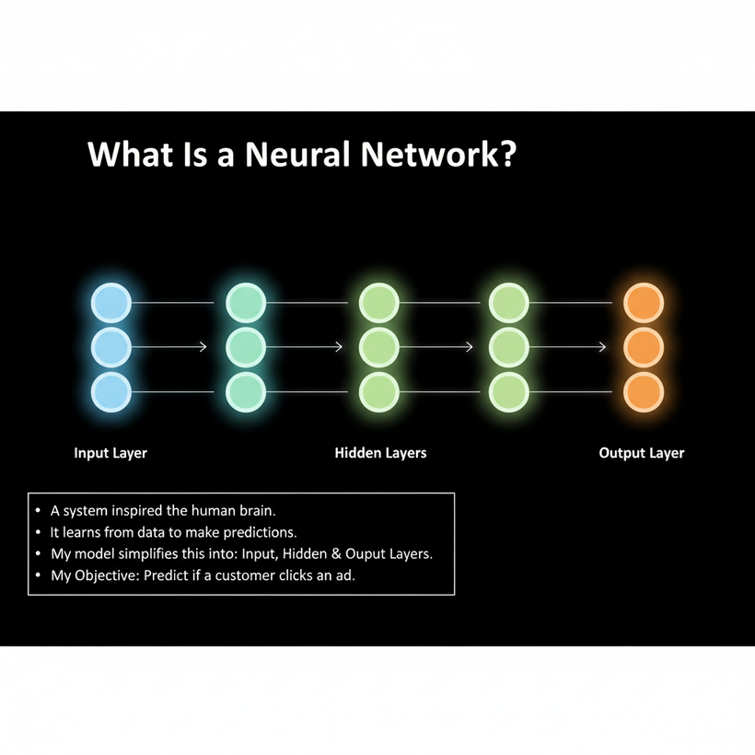
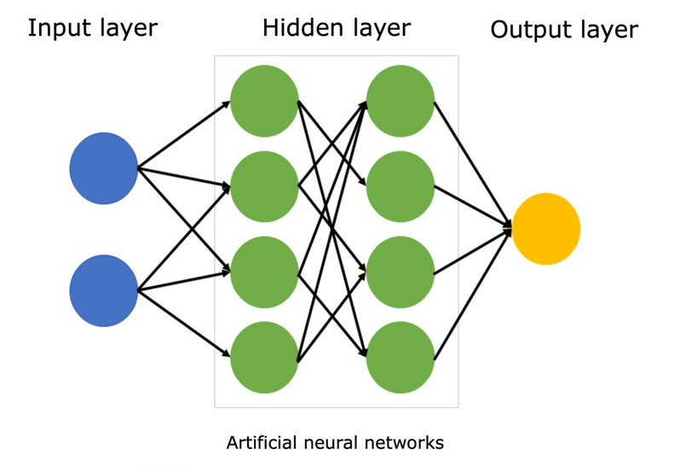

What Is a Neural Network?
I see a neural network as a computational model inspired by the structure of the human brain. It's designed to recognize patterns and make decisions.
Its core purpose is to learn from vast amounts of data to produce accurate predictions.
It gets its name because its structure, with interconnected layers of nodes (neurons), is inspired by the biological brain.
My specific model is simplified into three essential components: the Input Layer (where data enters), the Hidden Layers (where the complex processing happens), and the Output Layer (where the prediction is made).
My Objective: I will use this model to simulate a common business task: predicting if an online customer will click on an advertisement, which is known as a classification problem.

Slide 3





Input Layer: The Data Entry Point
The Input Layer is where the network receives the initial, raw data. Each piece of information I feed into the network is called an input feature.
My Data Example (Customer Profile): I chose features that influence online ad clicking. I will trace a single customer through the network.
Example Customer Data: For my simulation, the customer has spent 8 minutes on the site, is using a Mobile device, and has 2 previous clicks. I will highlight the values for my demonstration.
Feature 2 Device Type (Mobile/Desktop): Where the customer is viewing the ad. I use a simple one-hot encoding (Mobile = 1, Desktop = 0).
Feature 1 Time on Site (Minutes): How long the customer has been browsing.
Feature 3 Previous Clicks (Count): The customer's history of interacting with similar ads.

Slide 4

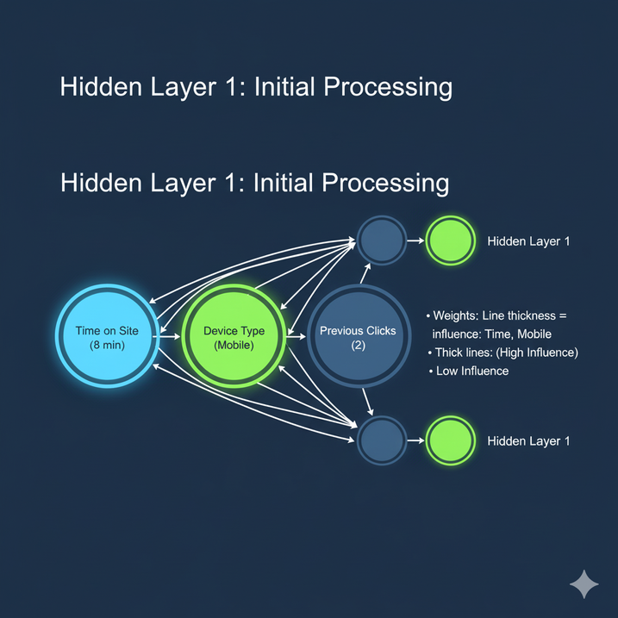
Hidden Layer 1: Initial Processing and Weight Assignment
The neurons in this first hidden layer are where the first level of calculation occurs. Each neuron takes the inputs, applies a weighted sum, and then passes the result through an activation function (like ReLU, for instance).
Theoretical Concept: Weights (w): The influence of any given input is determined by its weight. I represent these weights by the thickness of the connection line. A thicker line means a higher weight, meaning that feature has a stronger influence on the neuron's output.
Simulating Processing: I have trained my network to believe that Time on Site and Device Type (Mobile) are much more reliable indicators of a future click than Previous Clicks. Therefore, I made the connections from the high-influence features thicker.
This layer starts to turn simple data points (8 minutes) into meaningful signals for the next layer.

Slide 5

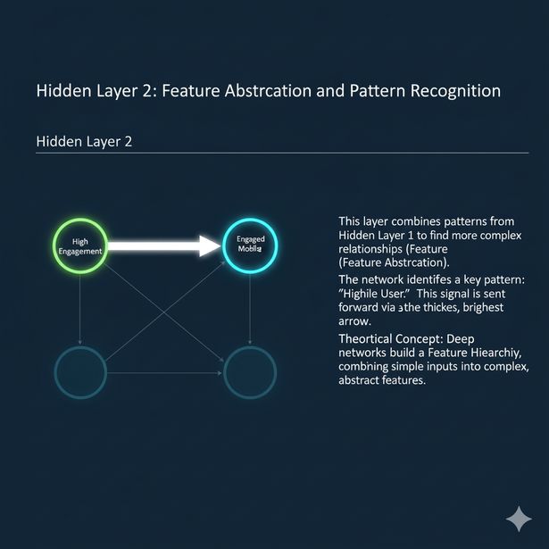


Hidden Layer 2: Feature Abstraction and Pattern Recognition
The second hidden layer is deeper and its role is to combine the preliminary patterns found in Layer 1. This process is called feature abstraction. It takes simple concepts and builds complex ones.
Simulating Processing:
The signals that were strongly activated in Layer 1 (due to the high weights on Time on Site and Mobile) flow here. This layer successfully combines those two signals into a single, high-confidence concept: "Highly Engaged Mobile User."
Theoretical Concept: Feature Hierarchy:
This is the power of a deep network. I've allowed the network to automatically construct a meaningful, abstract feature ("Engaged Mobile User") out of simple, raw inputs. The most active path from Layer 1 flows into a single neuron in Layer 2, signifying the successful recognition of this key pattern.
Simulating Processing:
The signals that were strongly activated in Layer 1 (due to the high weights on Time on Site and Mobile) flow here. This layer successfully combines those two signals into a single, high-confidence concept: "Highly Engaged Mobile User."

